Slide 1
Image Morphing Using Python Techniques
Srikalyan Bhavanthi
Cwid-50093474

Slide 2
Agenda
Abstract
Introduction
Problem and Goal
Literature
Methodology
Thresholding
Operations
Results
Impact
Conclusion

Slide 3
ABSTRACT
Morphological image processing boosts image analysis through altering the shape of objects for better clarity and feature extraction.
This project investigates five methods: Opening, Closing, Erosion, Dilation, and Black Hat.
OpenCV and NumPy libraries of Python were employed.
SSIM (Structural Similarity Index) was utilized to measure the outcomes.

Slide 4
Introduction
Previously, pictures were examined manually with the aid of callipers and densitometers, which were time-consuming and subject to errors.
Morphological operations shrink and enhance images by modifying structures.These techniques are widely used in medical imaging and manufacturing for the identification of defects and enhanced visualization.

Slide 5
Problem and Goal
Previous implementations in MATLAB and C++ had limitations.
MATLAB requires paid licenses.
C++ requires manual coding of every pixel operation.
Python solves both issues: it is open-source, has prebuilt libraries, and is beginner-friendly.

Slide 6
Literature
PCA: Reduces dimensionality, focuses on key features.
HOG: Extracts shape and edge information.
CNN: Learns hierarchical patterns in images automatically.
These techniques show the evolution from manual to intelligent image processing.

Slide 7
Methodology
Libraries used:
OpenCV: Reading images, applying operations
NumPy: Kernel and matrix operations
Matplotlib: Displaying results
Skimage.metrics: Calculating SSIM
Steps:
Load and convert image to grayscale
Apply Otsu’s thresholding
Perform morphological operations
Evaluate results using SSIM

Slide 8
Thresholding
Morphological operations need binary images.
Gray-scale pictures will result in confusion during processing.
Otsu's Thresholding finds the optimal threshold automatically.
It improves precision without requiring human intervention.

Slide 9
Operations
Erosion: Shrinks white areas; removes noise
Dilation: Expands white areas; fills gaps
Opening: Erosion followed by dilation (removes small noise)
Closing: Dilation followed by erosion (fills small holes)
Black Hat: Highlights dark elements on light backgrounds
These operations are applied using a sliding window (kernel).

Slide 10
Results
SSIM for Closing: 0.8548 → 17% difference
SSIM for Opening: ~15% difference
Dilation: Thicker shapes
Erosion: Thinner shapes
Black Hat: Highlights unwanted dark areas
Results prove that Python is effective for precision image morphing.

Slide 11
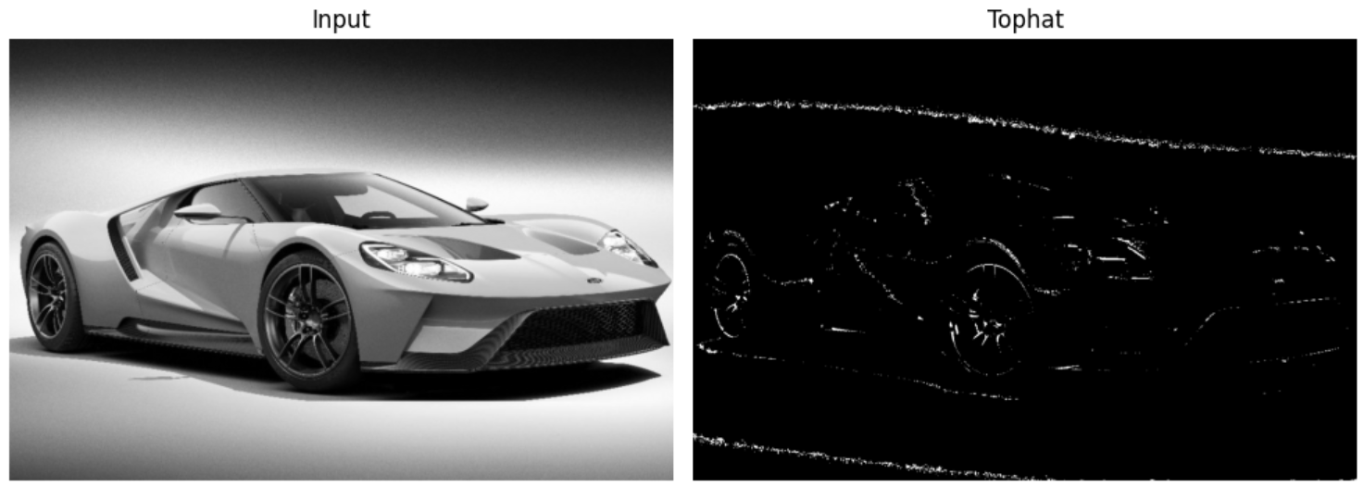
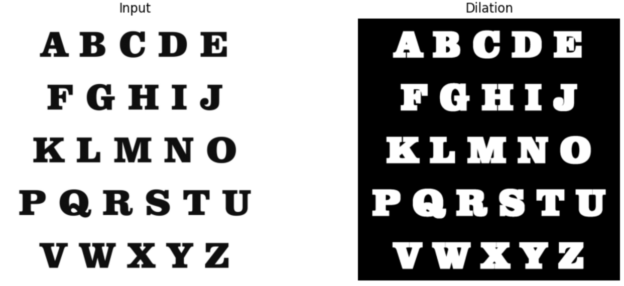
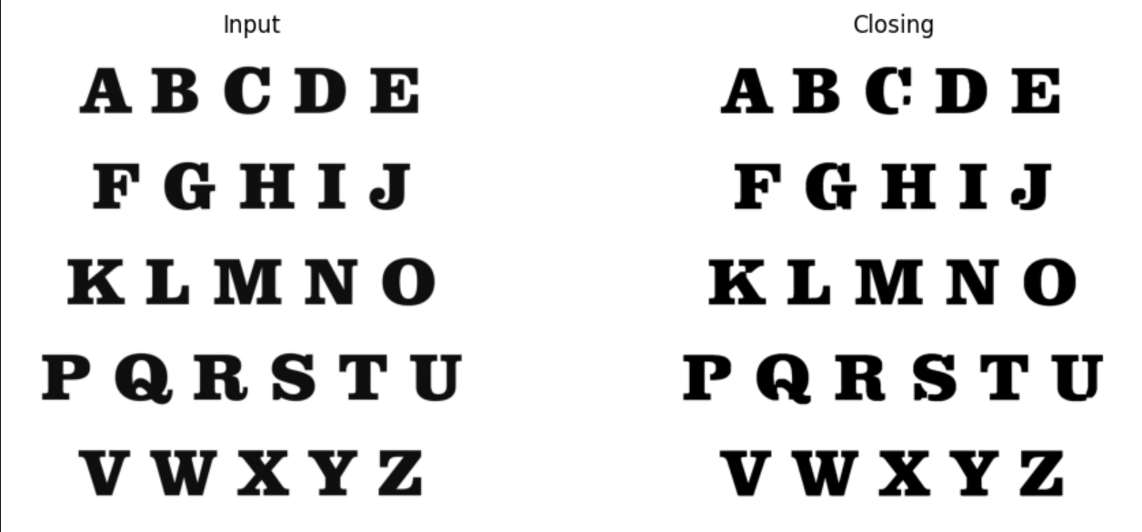
Example Outputs from Morphological Operations

Slide 12
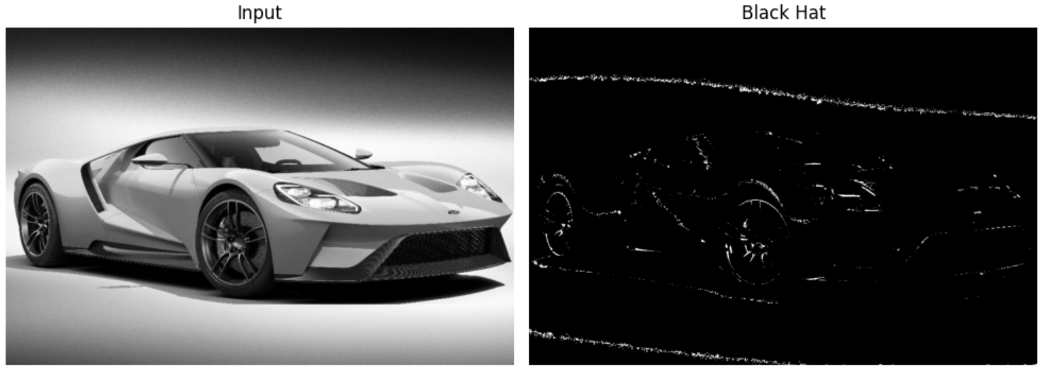
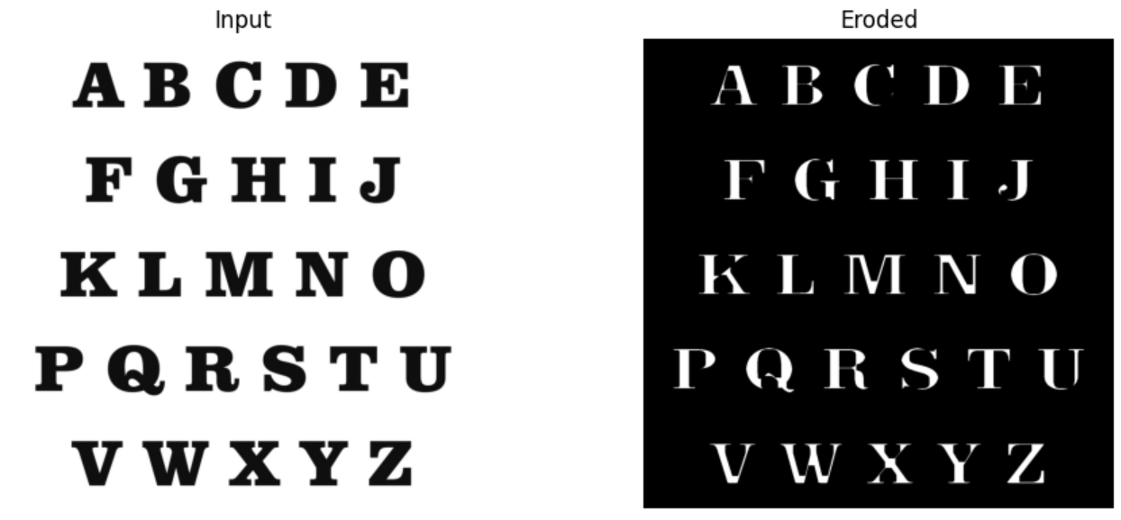
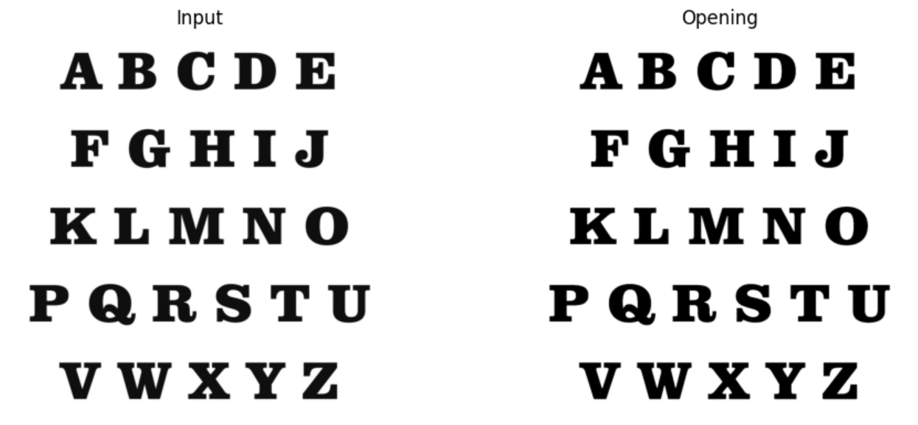
Example Outputs from Morphological Operations

Slide 13
Impact
Healthcare: Improves visibility of blood vessels in medical scans
Manufacturing: Detects faulty components like resistors and capacitors
Construction: Reveals micro-cracks in structural surfaces
Morphology makes hidden problems visible early, helping avoid serious consequences.

Slide 14
Conclusion
Morphological operations are powerful tools in image processing.
Using Python makes them efficient, flexible, and cost-effective.
The SSIM metric proved their impact even when changes are not visible to the eye.
This study shows how morphology can transform analysis in real-world industries.

Slide 15
Thank you

